Slide 1
Flight Delay Insurance System
[ 𝗖𝗜𝗦 𝟲𝟬𝟬:𝗠𝗮𝘀𝘁𝗲𝗿𝘀 𝗣𝗿𝗼𝗷𝗲𝗰𝘁 ]
( 𝐒𝐩𝐫𝐢𝐧𝐠 𝟐𝟎𝟐𝟓 )
𝗣𝗿𝗲𝘀𝗲𝗻𝘁𝗮𝘁𝗶𝗼𝗻 𝗕𝘆:-
𝗩𝗶𝗻𝗮𝘆 𝗦𝗵𝗲𝘁𝘆𝗲

Slide 2
Introduction
Problem Statement: Flight delays and cancellations cause significant financial and emotional stress for travelers, with limited automated solutions for quick compensation.
Objective: To develop a seamless platform that combines flight booking with automated delay insurance, providing instant claims processing and compensation for affected passengers.
Why it matters?
Travelers lose $billions annually due to flight delays.
Current claim processes are manual and time-consuming.
No integrated solution exists for booking + insurance.
Growing demand for travel protection post-COVID.
Need for transparent and instant compensation.

Slide 3
Dataset Overview
Amadeus Flight API (Real-time flight data):
Flight Search & Pricing
Real-time flight availability
Multi-city routing options
Cabin class availability
Airline Information:
IATA/ICAO airline codes
Carrier details and logos
Operating airlines data
Codeshare information
Airport Data:
Airport codes and locations
City/Airport search functionality
Terminal information
Geographic coordinates
Booking Details:
Fare rules and conditions
Baggage allowance
Meal preferences
Seat availability

Slide 4
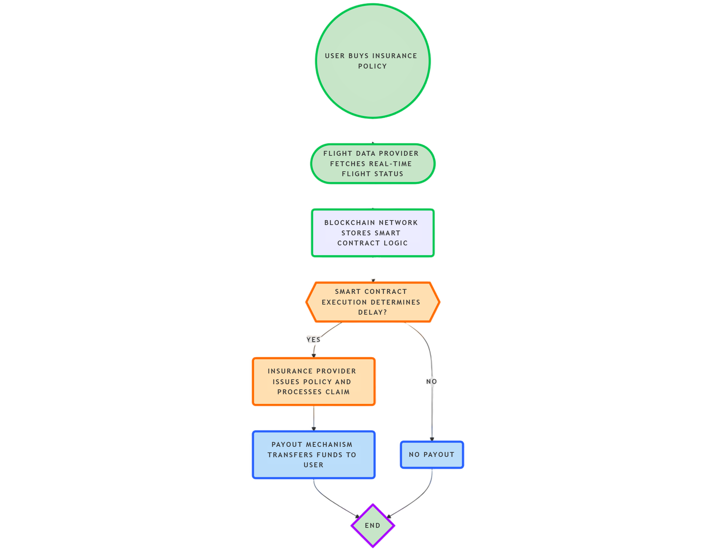
Methodology: System Workflow
Insurance Policy Flow
User Initiation:
User purchases flight delay insurance policy
Policy details stored securely in database
Real-time Flight Monitoring
Amadeus API continuously tracks flight status
System monitors departure and arrival times
Real-time updates on flight delays
Smart Contract Integration
Automated claim verification process
Pre-defined delay thresholds
Transparent policy execution rules

Slide 5
Methodology: System Workflow
Insurance Policy Flow
Claim Processing Logic:
Smart contract evaluates delay conditions
Automated decision-making process
Two possible outcomes:
YES: Claim approved → Payment initiated
NO: No delay detected → No payout
Payment Processing
Automated payout mechanism
Direct fund transfer to user account
Instant compensation on verified claims
Payment Processing
⚡ Instant automated processing +🔒 Secure and transparent
💸 No manual claim filing needed + ✅ Objective verification system

Slide 6
IMPLEMENTATION STACK
So many airplanes and flights!

Slide 7







Technical Implementation
System Architecture
Frontend: Next.js, TypeScript, Tailwind CSS
Backend: Node.js, Prisma ORM
APIs: Amadeus, AvaiationStack, Travel Payout, Stripe Integration
Database: PostgreSQL
Key Features Implemented
User Authentication:
Secure login/signup
Email verification
Password recovery
Current Progress
✅ User authentication system / ✅ Flight search functionality / ✅ Booking system
🔄 Payment integration / 🔄 Insurance claims processing
Flight Search & Booking:
Real-time availability
Multi-currency support
Dynamic pricing
Insurance Integration:
Policy generation
Automated monitoring
Instant claims processing

Slide 8
Live Demo
Flight Delay Insurance System
Leverages blockchain and smart contracts to provide seamless, automated compensation for flight delays, ensuring transparency, efficiency, and hassle-free claims for travelers.

Slide 9

Thank You!

